Slide 1
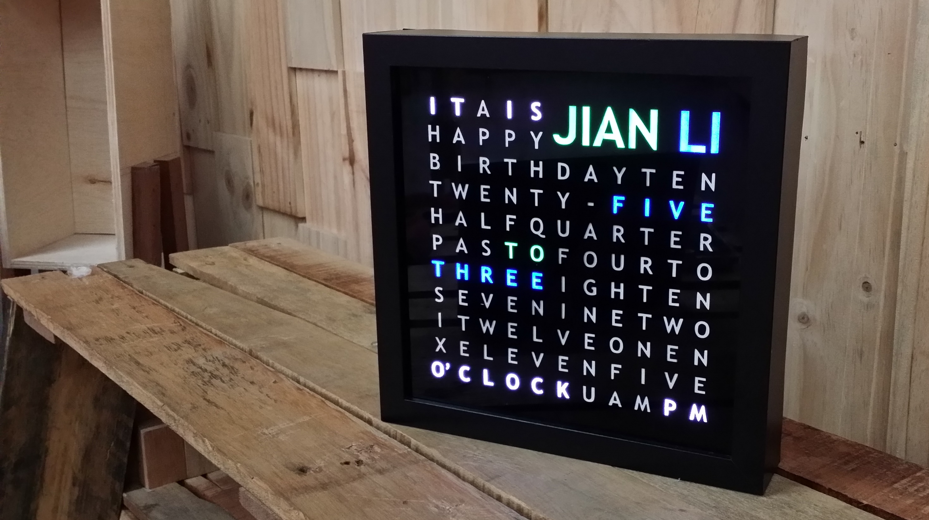
Notes:
Hi! I am Jian Li from the incoming batch for 2015 and I am here to present my LED word clock. I started this about 4 months ago and took about 2 months to complete this. Words are illuminated by the LEDs to display the time.

Slide 2
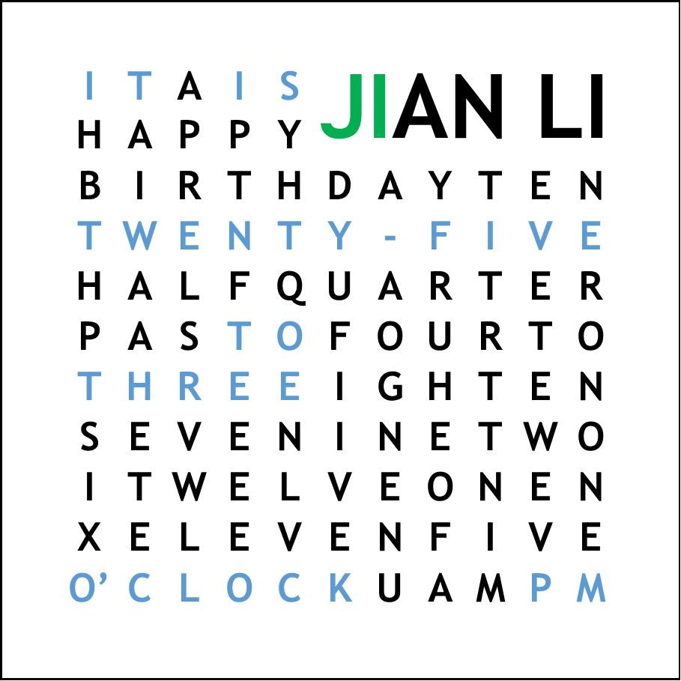
“IT IS TWENTY-FIVE (MINUTES) TO THREE O’CLOCK” + 2 letters (2 Minutes) = 2:37 PM
Notes:
A common question I get is “How do you read the clock?”. In this example, “IT IS TWENTY-FIVE (MINUTES) TO THREE O’CLOCK”, 2:35 pm. Note that the minutes notations are in increments of 5 mins each. As such, I used each letter in my name to denote each minute in between. Hence, the time is 2:37pm.

Slide 3
Inputs
Processor
Outputs
Push Buttons
Arduino Uno
Addressable LED array
Real Time Clock
Notes:
The Arduino reads the Time from the Real Time Clock Module then decides how it should light up the words to display the time. Push buttons are added to configure basic settings without having to reprogram the Arduino.

Slide 4
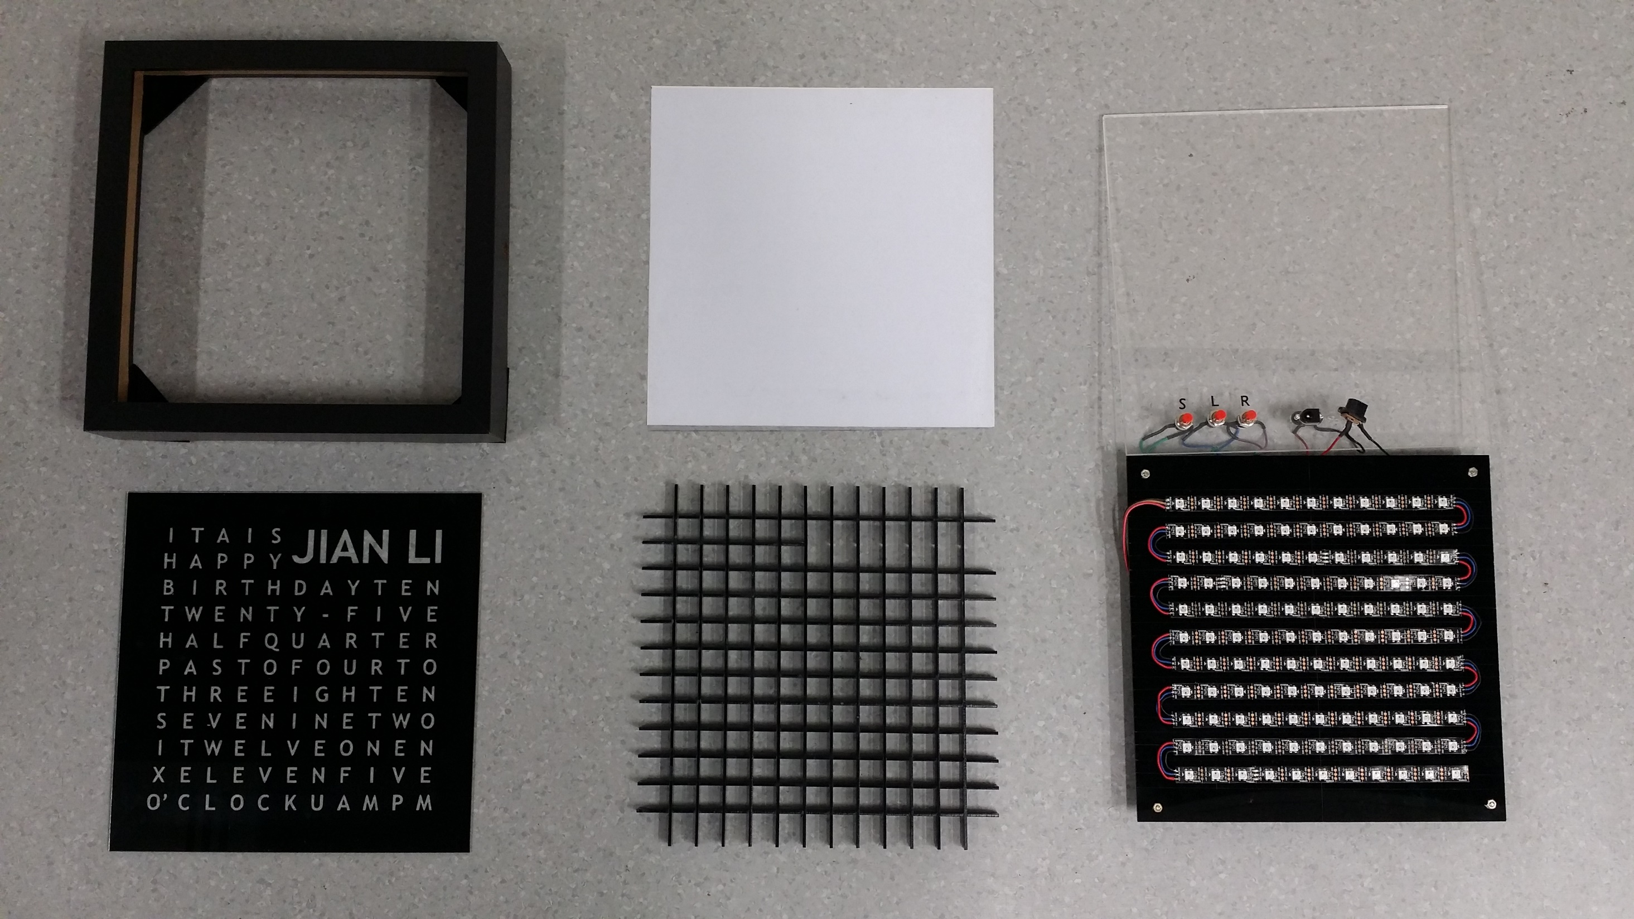
Notes:
Here are the various component layers laid out. I had an IKEA Photo Frame lying around and decided to use this as the body for the clock. The glass panel provided was used as the Clock Face. The electronics layer is not shown as it is on the underside of the LED array.

Slide 5
120 | 119 | 118 | 117 | 116 | 115 | 114 | 113 | 112 | 111 | 110
99 | 100 | 101 | 102 | 103 | 104 | 105 | 106 | 107 | 108 | 109
98 | 97 | 96 | 95 | 94 | 93 | 92 | 91 | 90 | 89 | 88
77 | 78 | 79 | 80 | 81 | 82 | 83 | 84 | 85 | 86 | 87
76 | 75 | 74 | 73 | 72 | 71 | 70 | 69 | 68 | 67 | 66
55 | 56 | 57 | 58 | 59 | 60 | 61 | 62 | 63 | 64 | 65
54 | 53 | 52 | 51 | 50 | 49 | 48 | 47 | 46 | 45 | 44
33 | 34 | 35 | 36 | 37 | 38 | 39 | 40 | 41 | 42 | 43
32 | 31 | 30 | 29 | 28 | 27 | 26 | 25 | 24 | 23 | 22
11 | 12 | 13 | 14 | 15 | 16 | 17 | 18 | 19 | 20 | 21
10 | 9 | 8 | 7 | 6 | 5 | 4 | 3 | 2 | 1 | 0
Words
2 Letters | 3 Letters | 4 Letters | 5 Letters | 6 Letters | 7 Letters
IT | ONE | FOUR | THREE | ELEVEN | QUARTER
IS | TWO | FIVE x 2 | SEVEN | TWELVE | MINUTES
AM | SIX | NINE | EIGHT | O’CLOCK
PM | TEN x 2 | HALF |  | TWENTY
TO |  | PAST
Notes:
Taking into account the area of the clock face and the spacing between each LED on the LED strip, I got an array of 11 x 11 letters. What you can see here is a Planning Table I designed to plan the words out. Each square is labelled with the address for each LED and a table with words catagorized by the number of letters used was created.

Slide 6
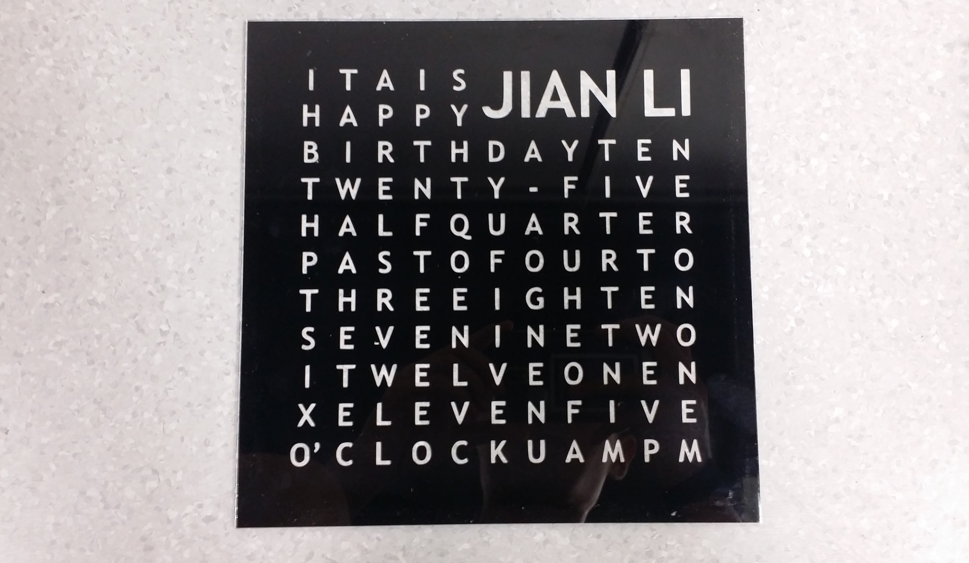
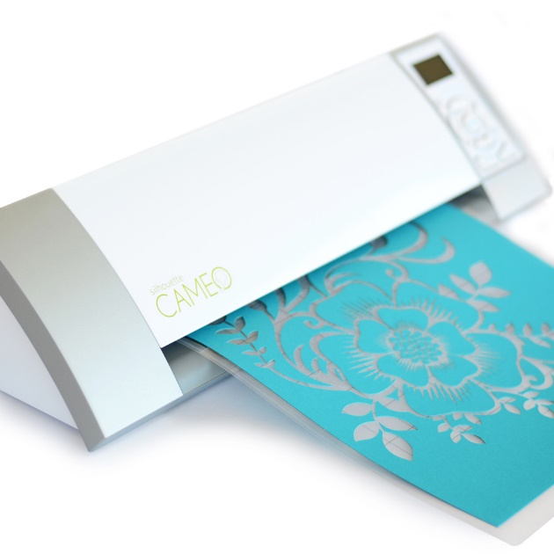
Notes:
I used Microsoft Publisher to arrange the letters into an 11 x 11 grid and exported it as an image file. Using the proprietary software to be used with the vinyl cutter, the image was traced and cut using the vinyl cutter. The vinyl was cut with the adhesive facing up so that it can be stuck on the outer side of the glass.

Slide 7
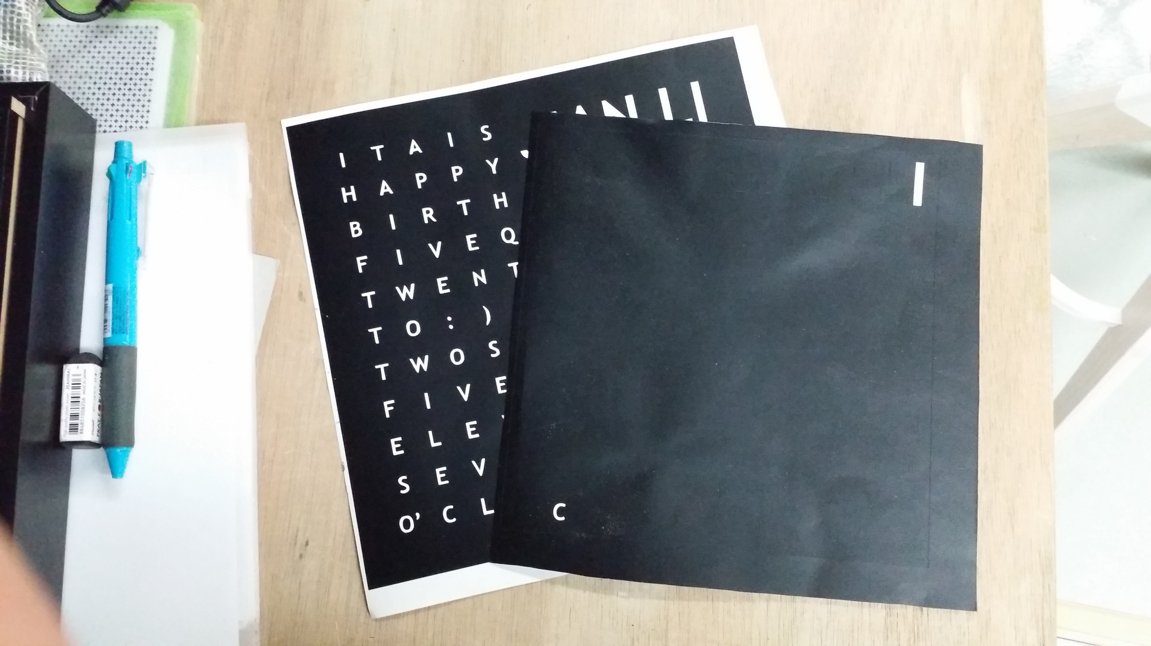
Notes:
I had about 2 failed attempts at this. The 1st one was too small. Like they say, “Measure twice, cut once”. 2nd one was not inverted to allow it to be stuck on the underside of the glass.

Slide 8
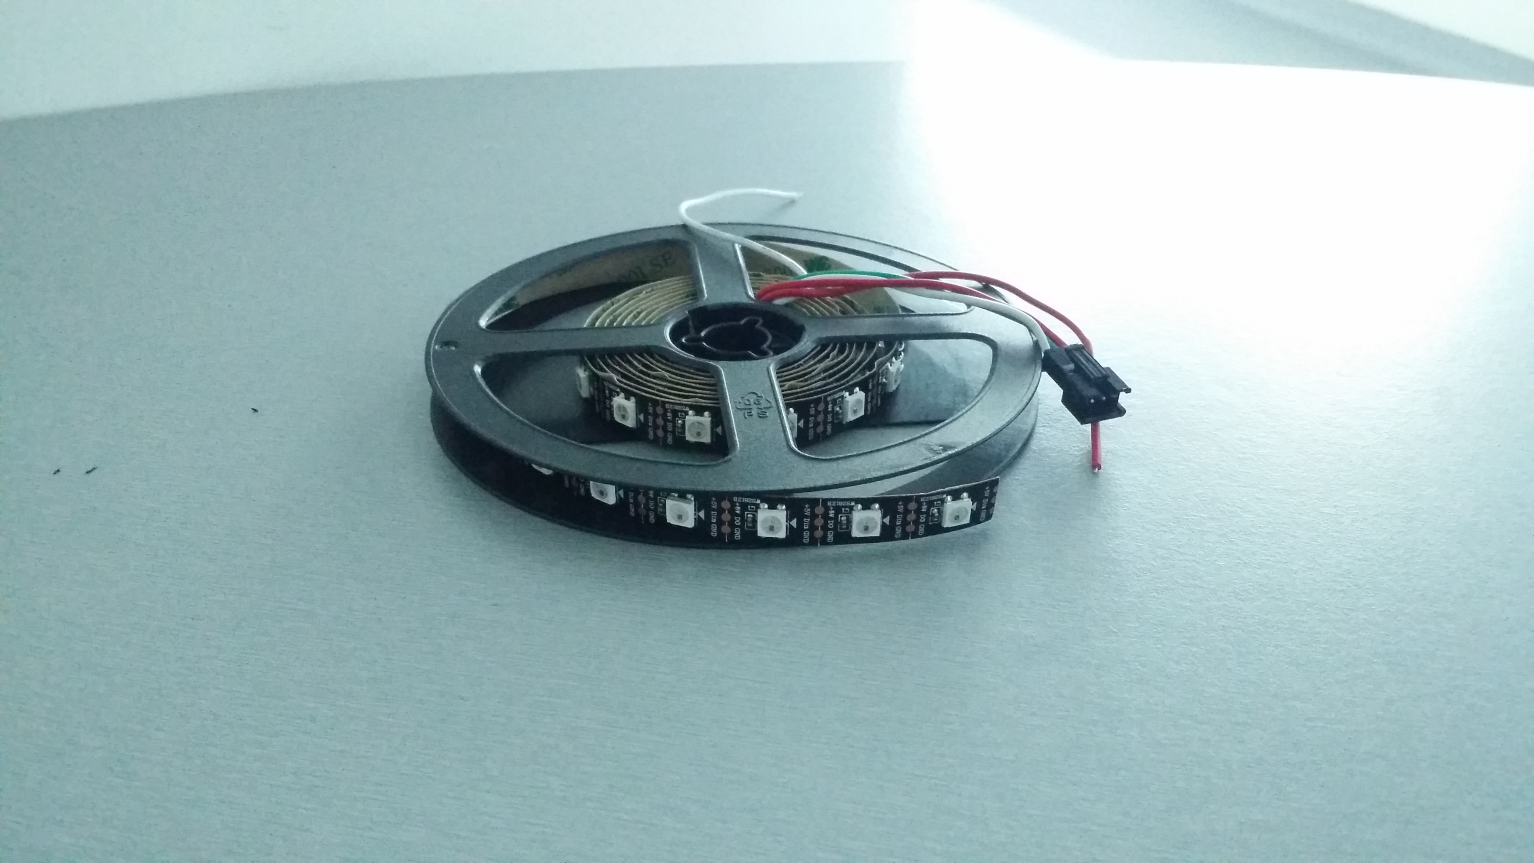
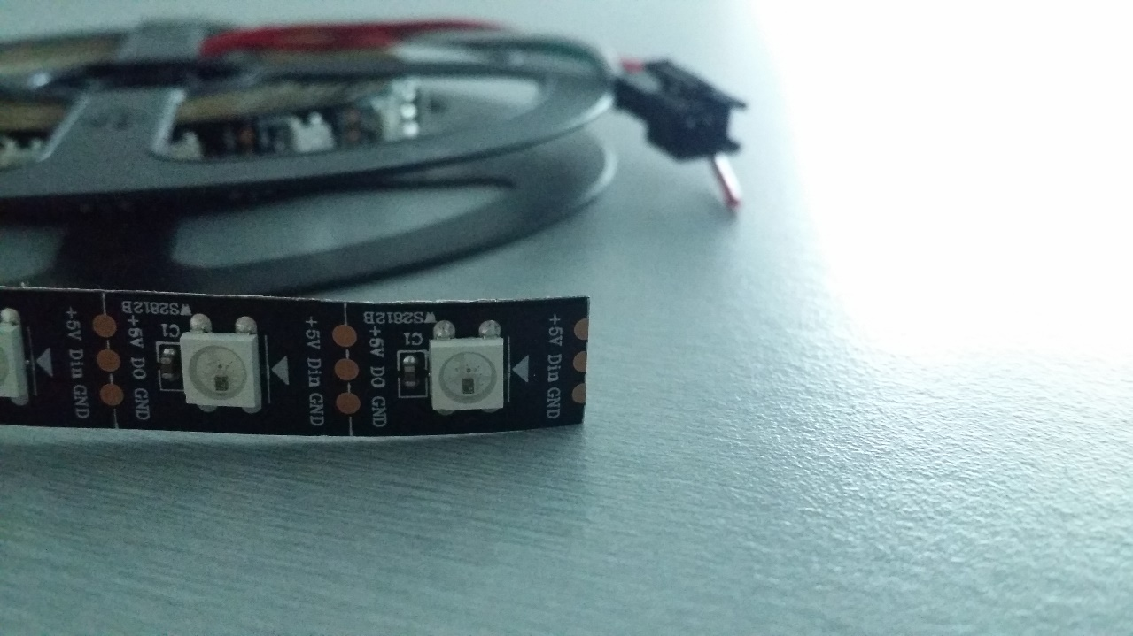
Notes:
I used Addressable LED Strips for the word clock. This allows me to control the 121 LEDs I have to use individually, not only to turn on or off, but to also change its colour. The hard part of the coding is dealt by the library. All I had to do was manipulate the functions provided.

Slide 9
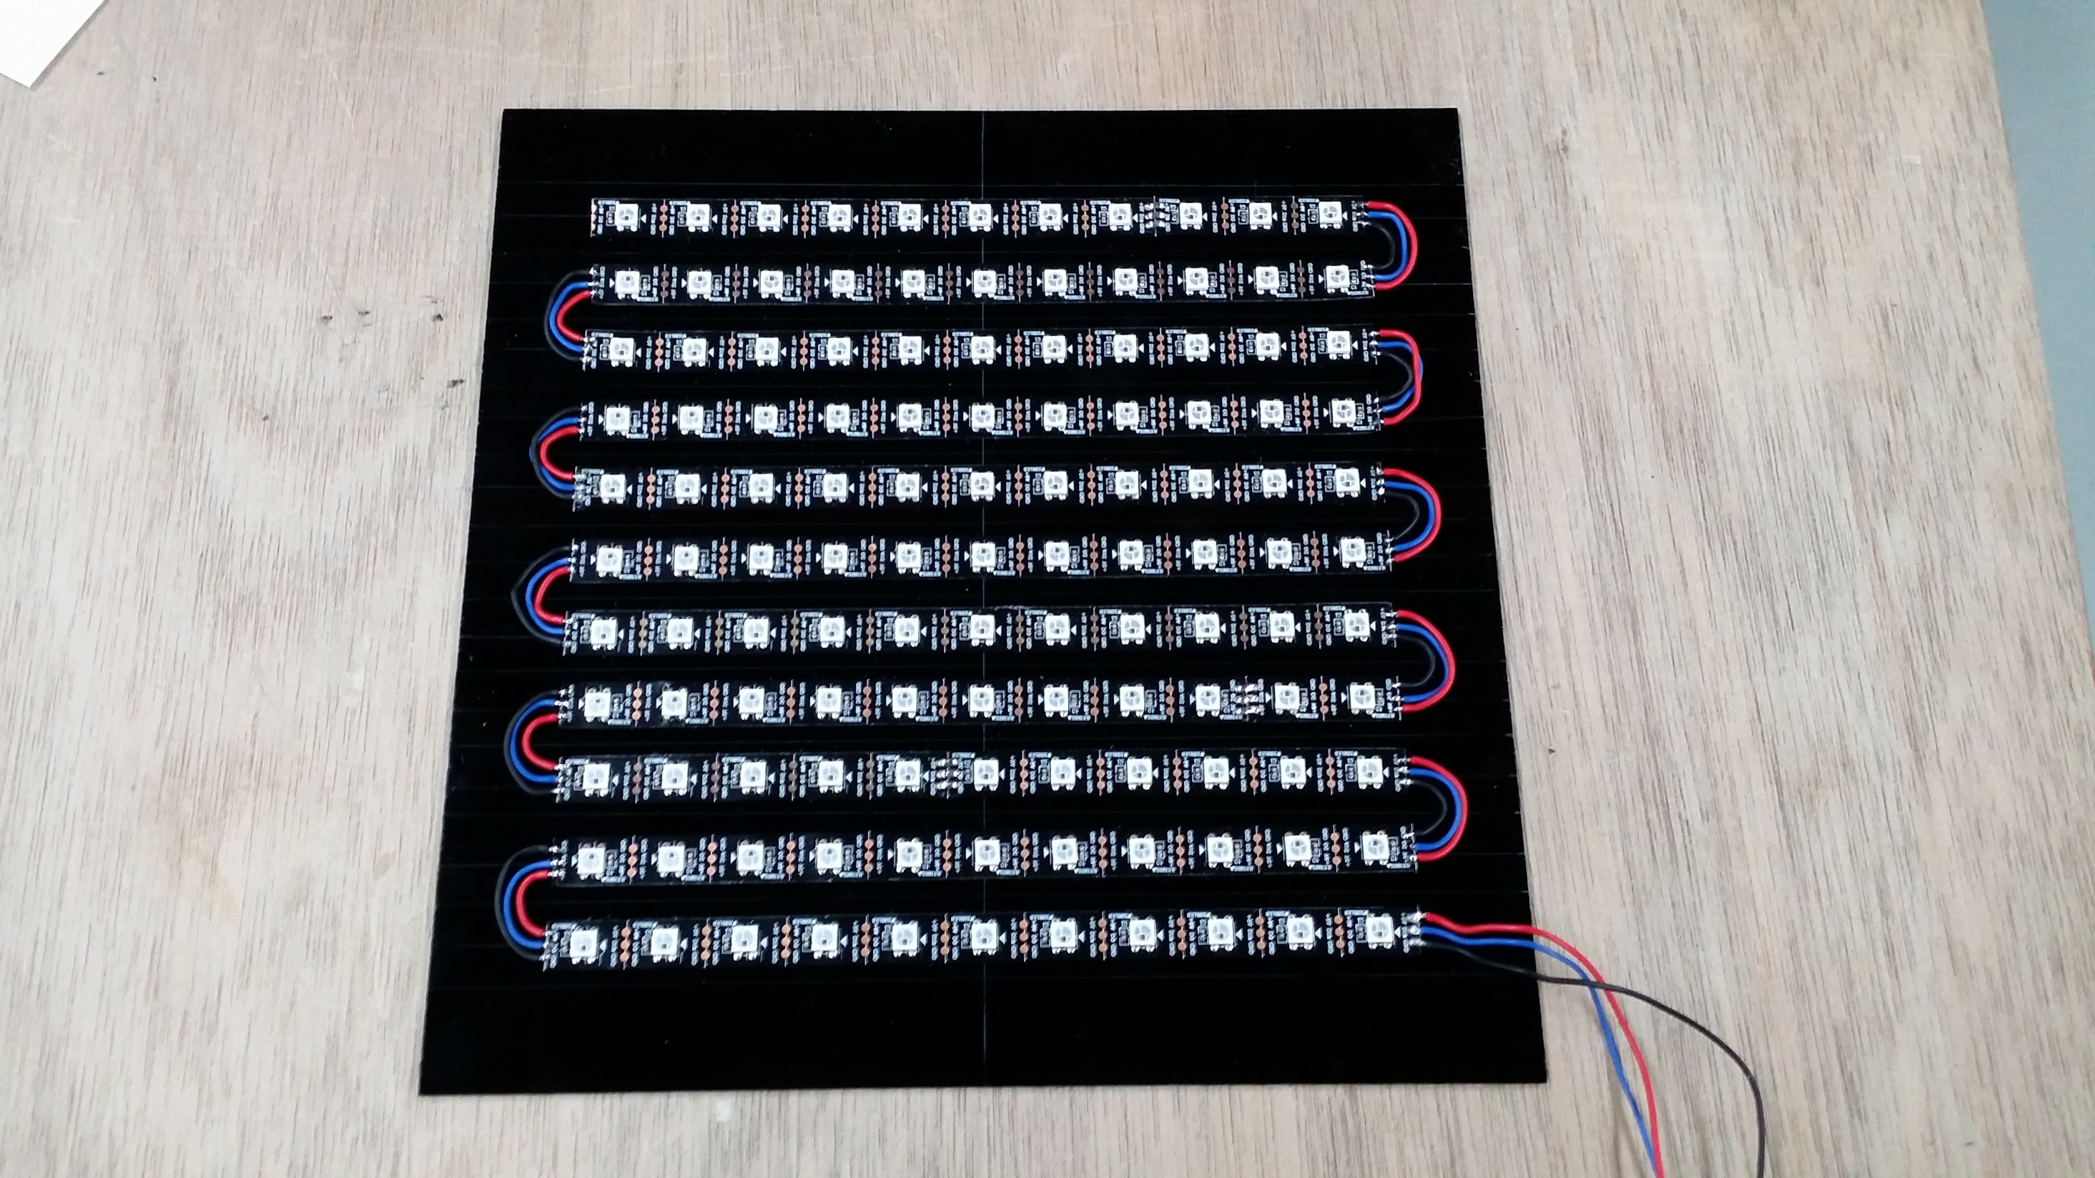
120
0
Notes:
Strips of 11 LEDs each are daisy chained together to form the array. The address corresponds to the sequence of which the LED is laid. The LED strips are than attached onto an acrylic panel with the provided adhesive.

Slide 10
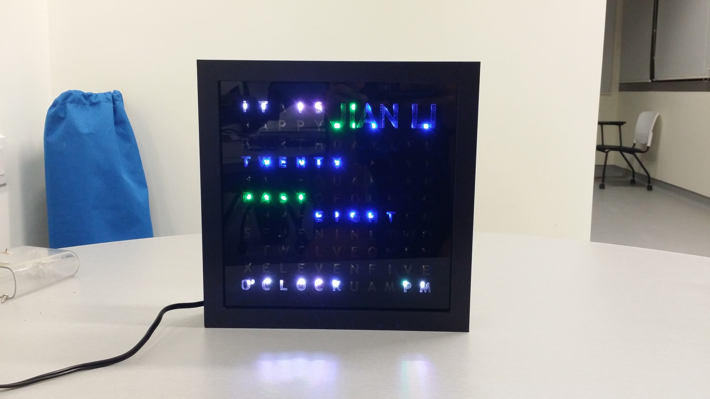
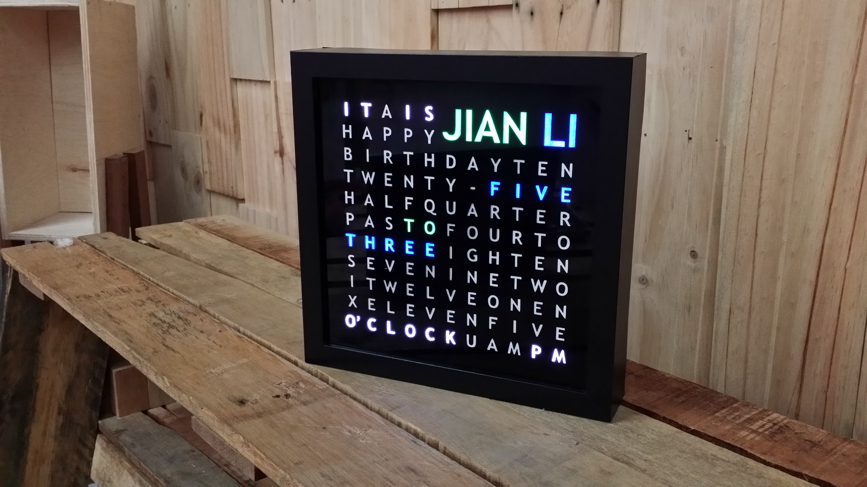
Notes:
This picture shows the need for diffusion of the lights from the LED. On the left, “spotlighting” is observed without diffusion. Diffusion makes the letters appear evenly illuminated. I used a translucent plastic sheet and white paper for this.

Slide 11
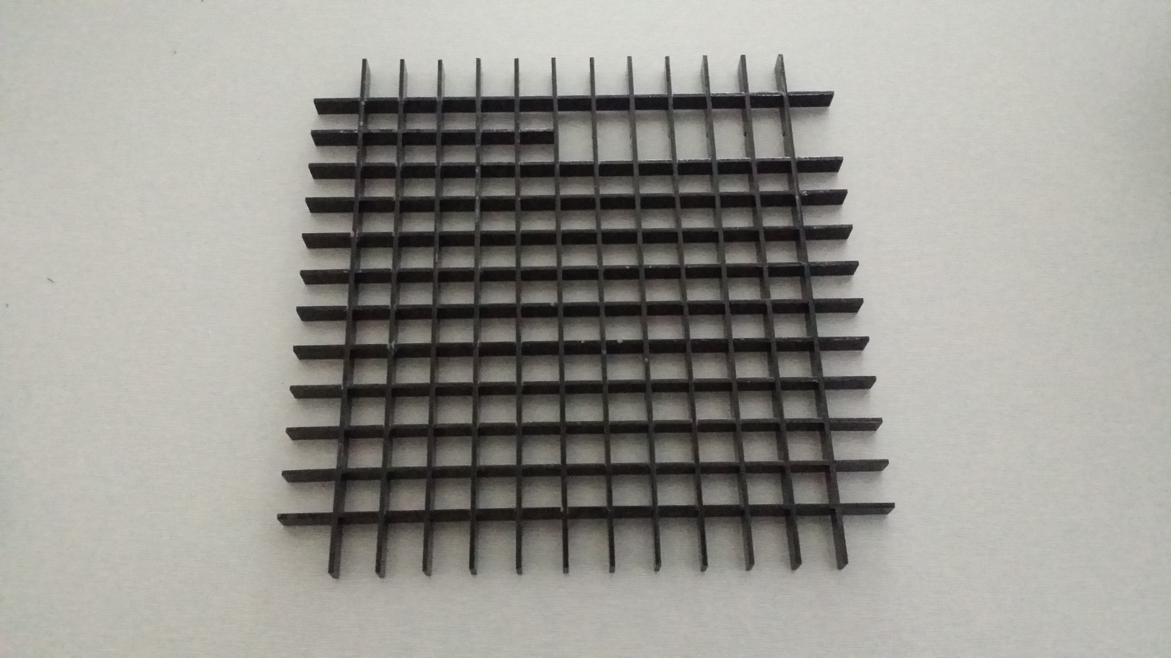
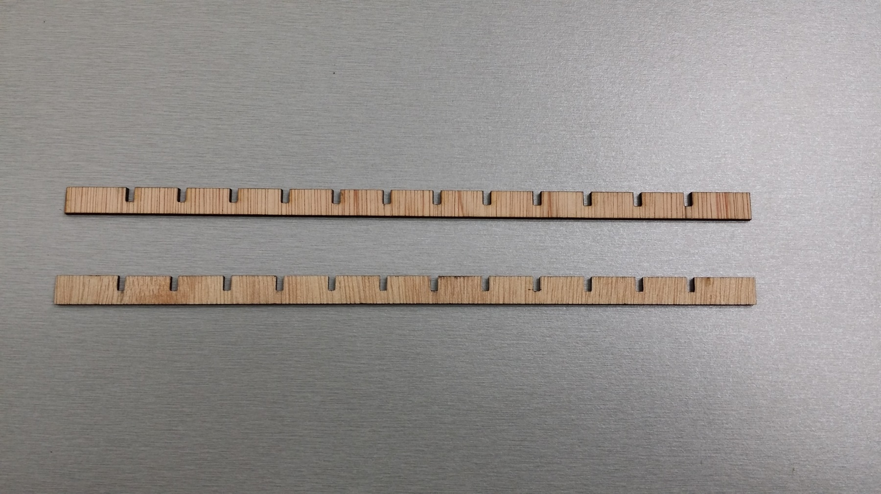
Notes:
To isolate each LED to prevent it from illuminating adjacent letters, a baffle layer was made. It is made with intersecting pieces made out of laser cut acrylic pieces.

Slide 12
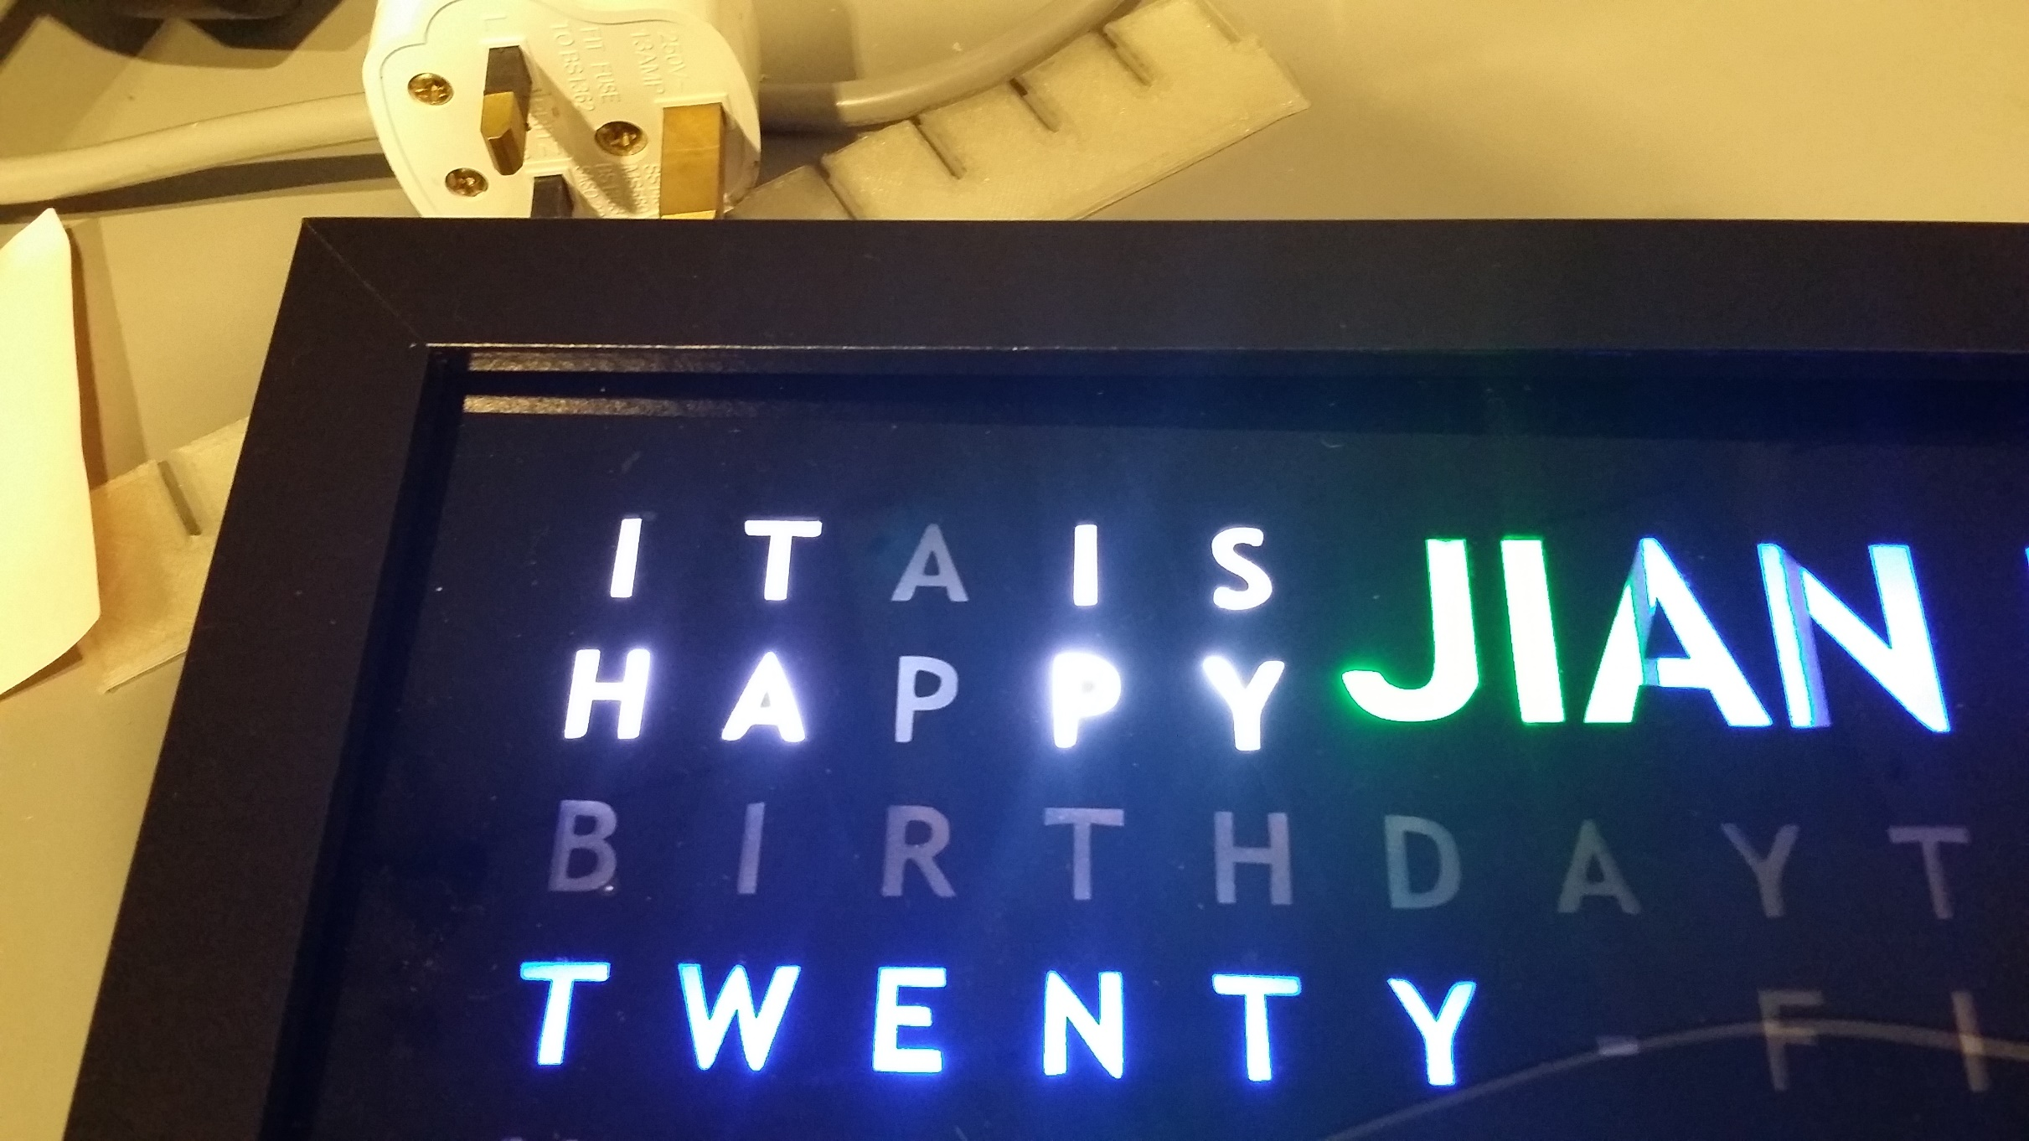
Notes:
And in this picture, you can see that without the baffle, the letters below were lit up. Note that the letters beside were not lit up as there were already some pieces in place then.

Slide 13
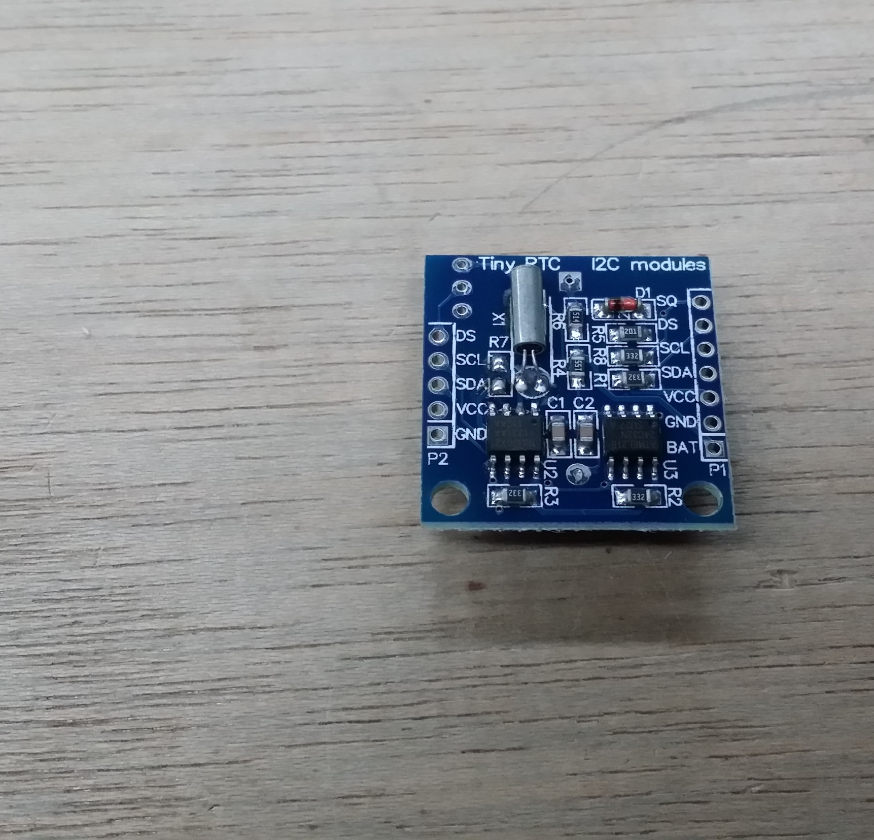
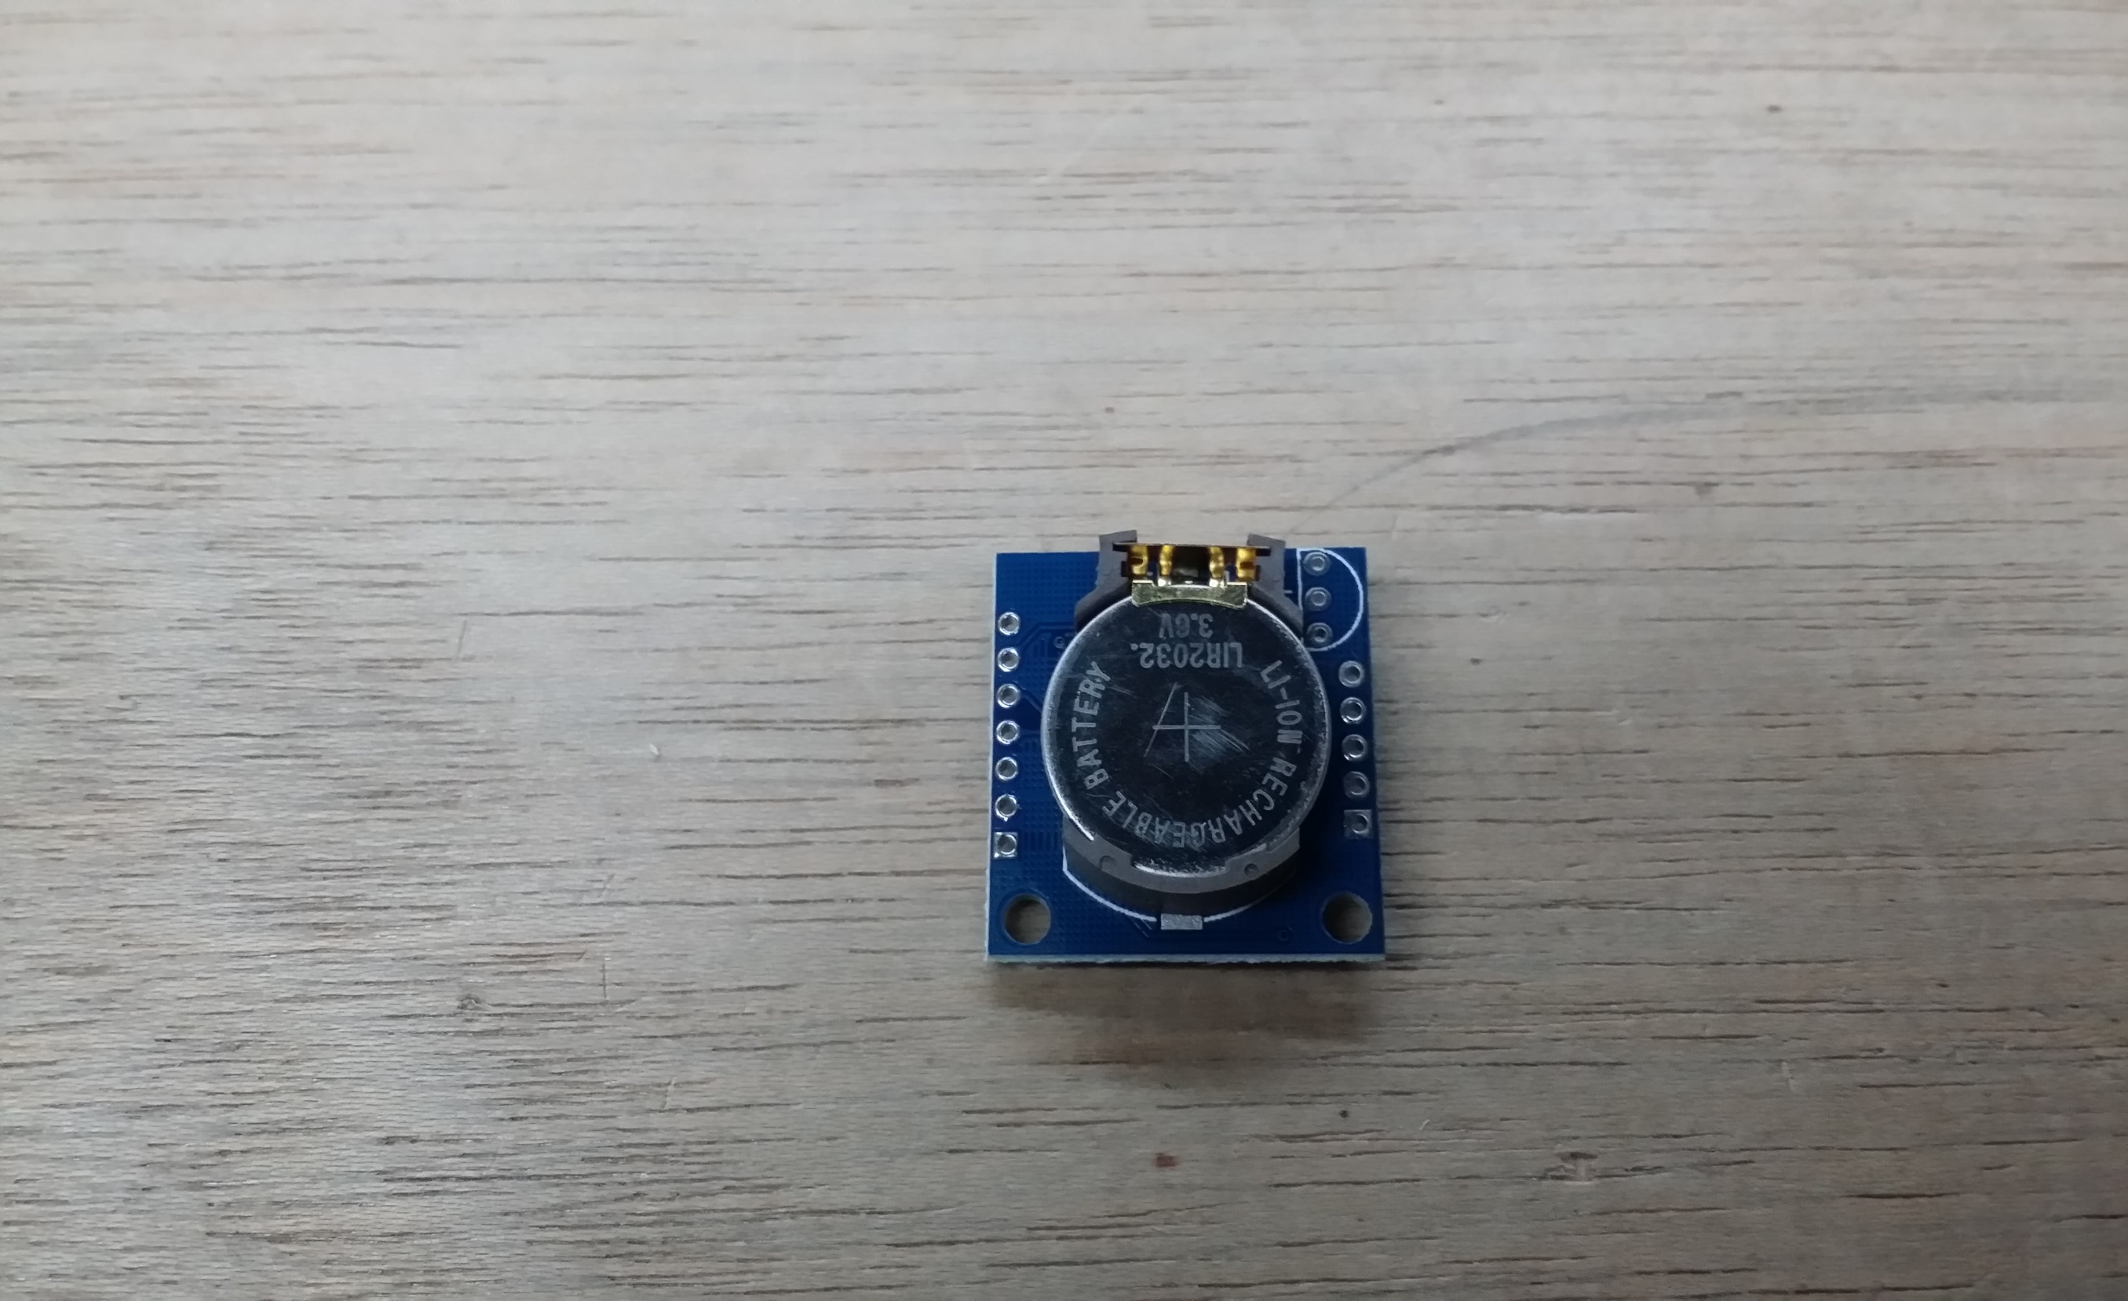
Notes:
I got this Real Time Clock Module from a China Webstore for about $4. This module is a plug-and-play kind of device; I had to do very little to connect it to the Arduino and get it working. It has a rechargeable Button cell battery as a backup battery. This allows it to keep track of the time even when the Arduino is turned off.

Slide 14
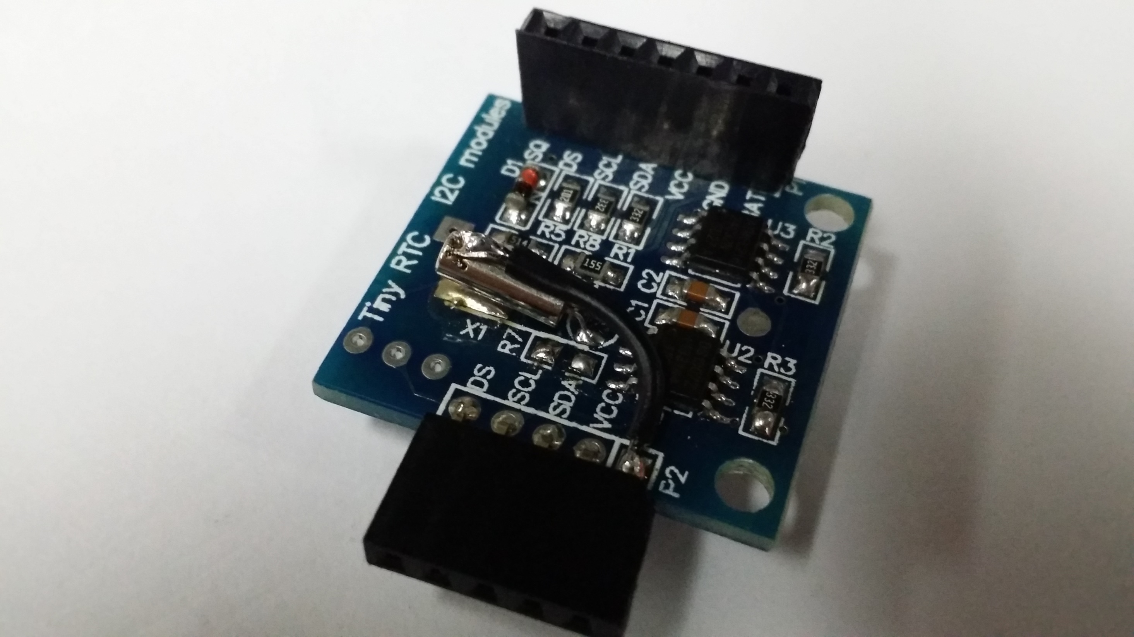
Notes:
The RTC module from China had an issue initially. It was unable to keep track of the time after the Arduino was turned off. After doing a search online I found that a solution which suggested grounding the crystal. I did so and it worked. I do not have a clue up till now why this is so though.

Slide 15
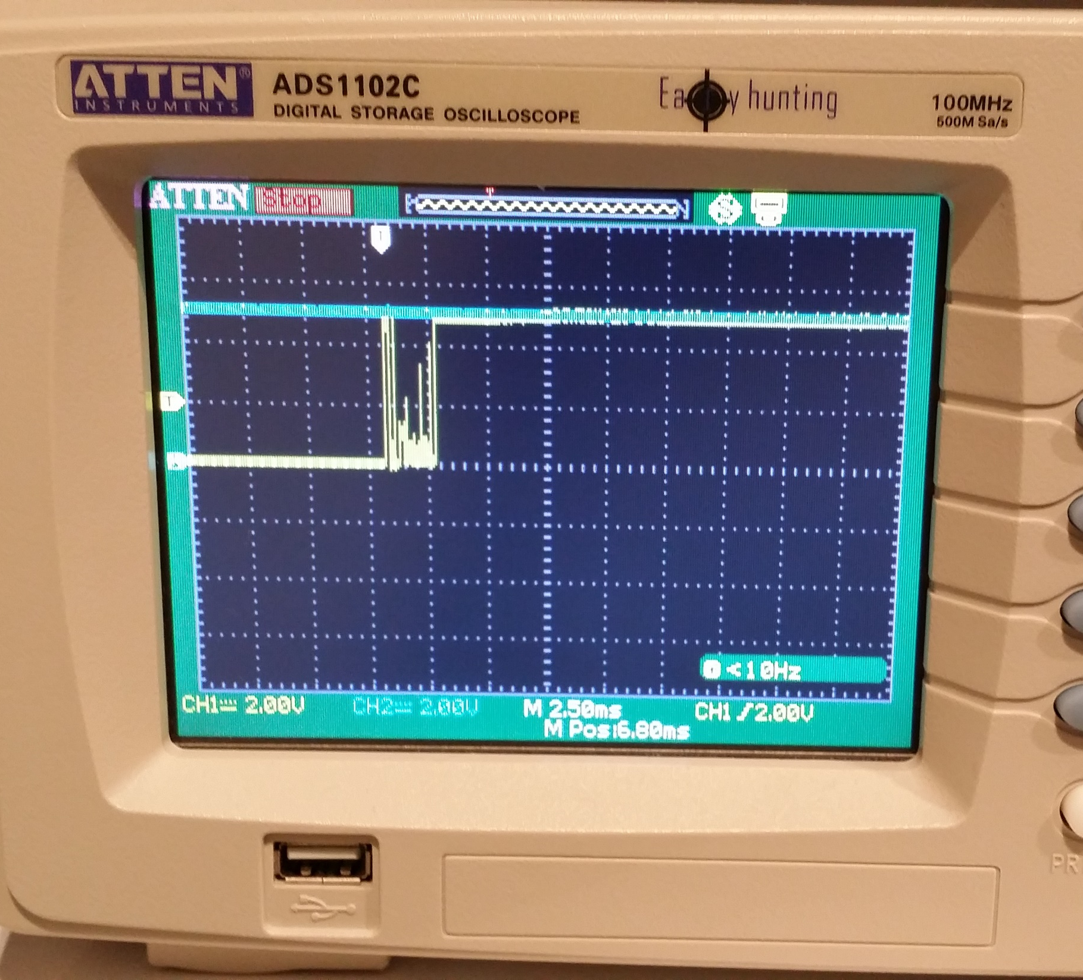
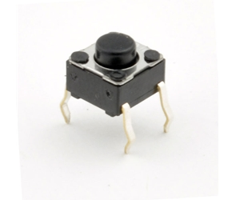
Notes:
When using pushbuttons, the contacts tend to “bounce” and produce unwanted logic signals as shown. This may cause conditions to be triggered prematurely. My initial solution to this was a software deboucing to wait for the logic state to settle. However, this would add many lines to my program and is not very efficient.

Slide 16
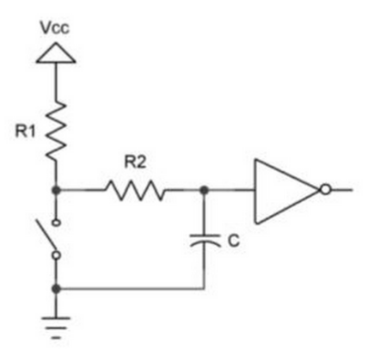
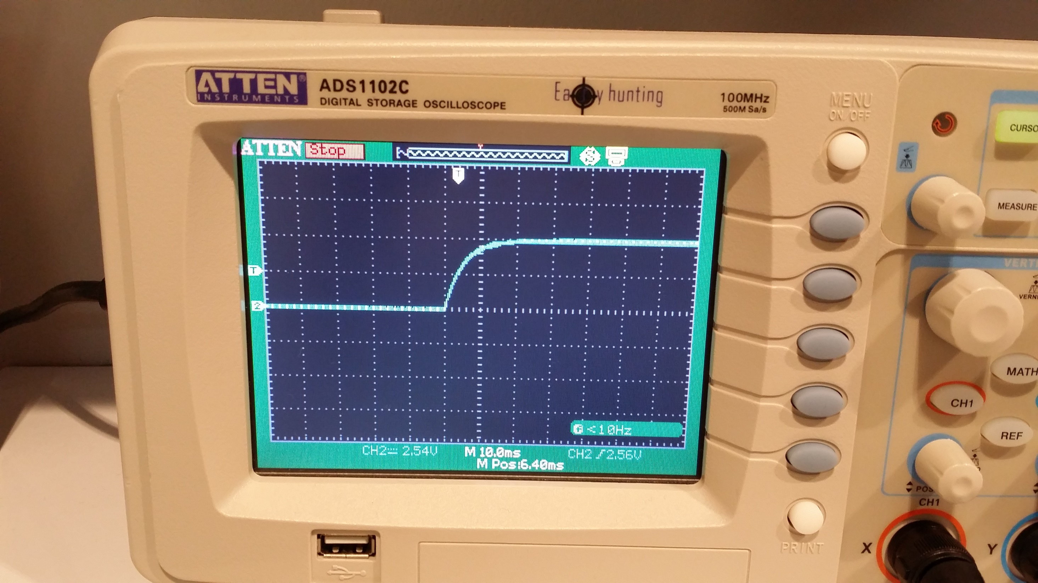
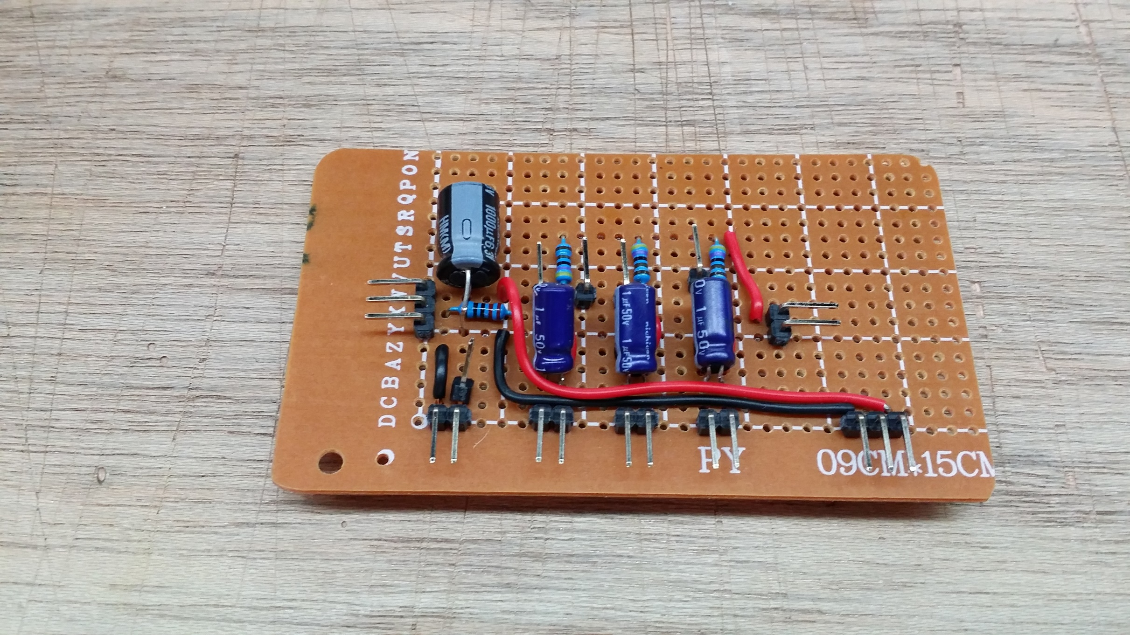
Notes:
I tend used an Resistor-Capacitor Filtering Circuit to “debounce” it. The smooth curve is produced by the capacitor charging/ discharging as the contacts are closed/ open.

Slide 17
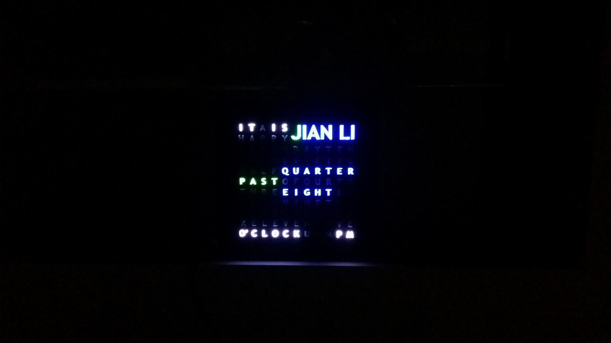
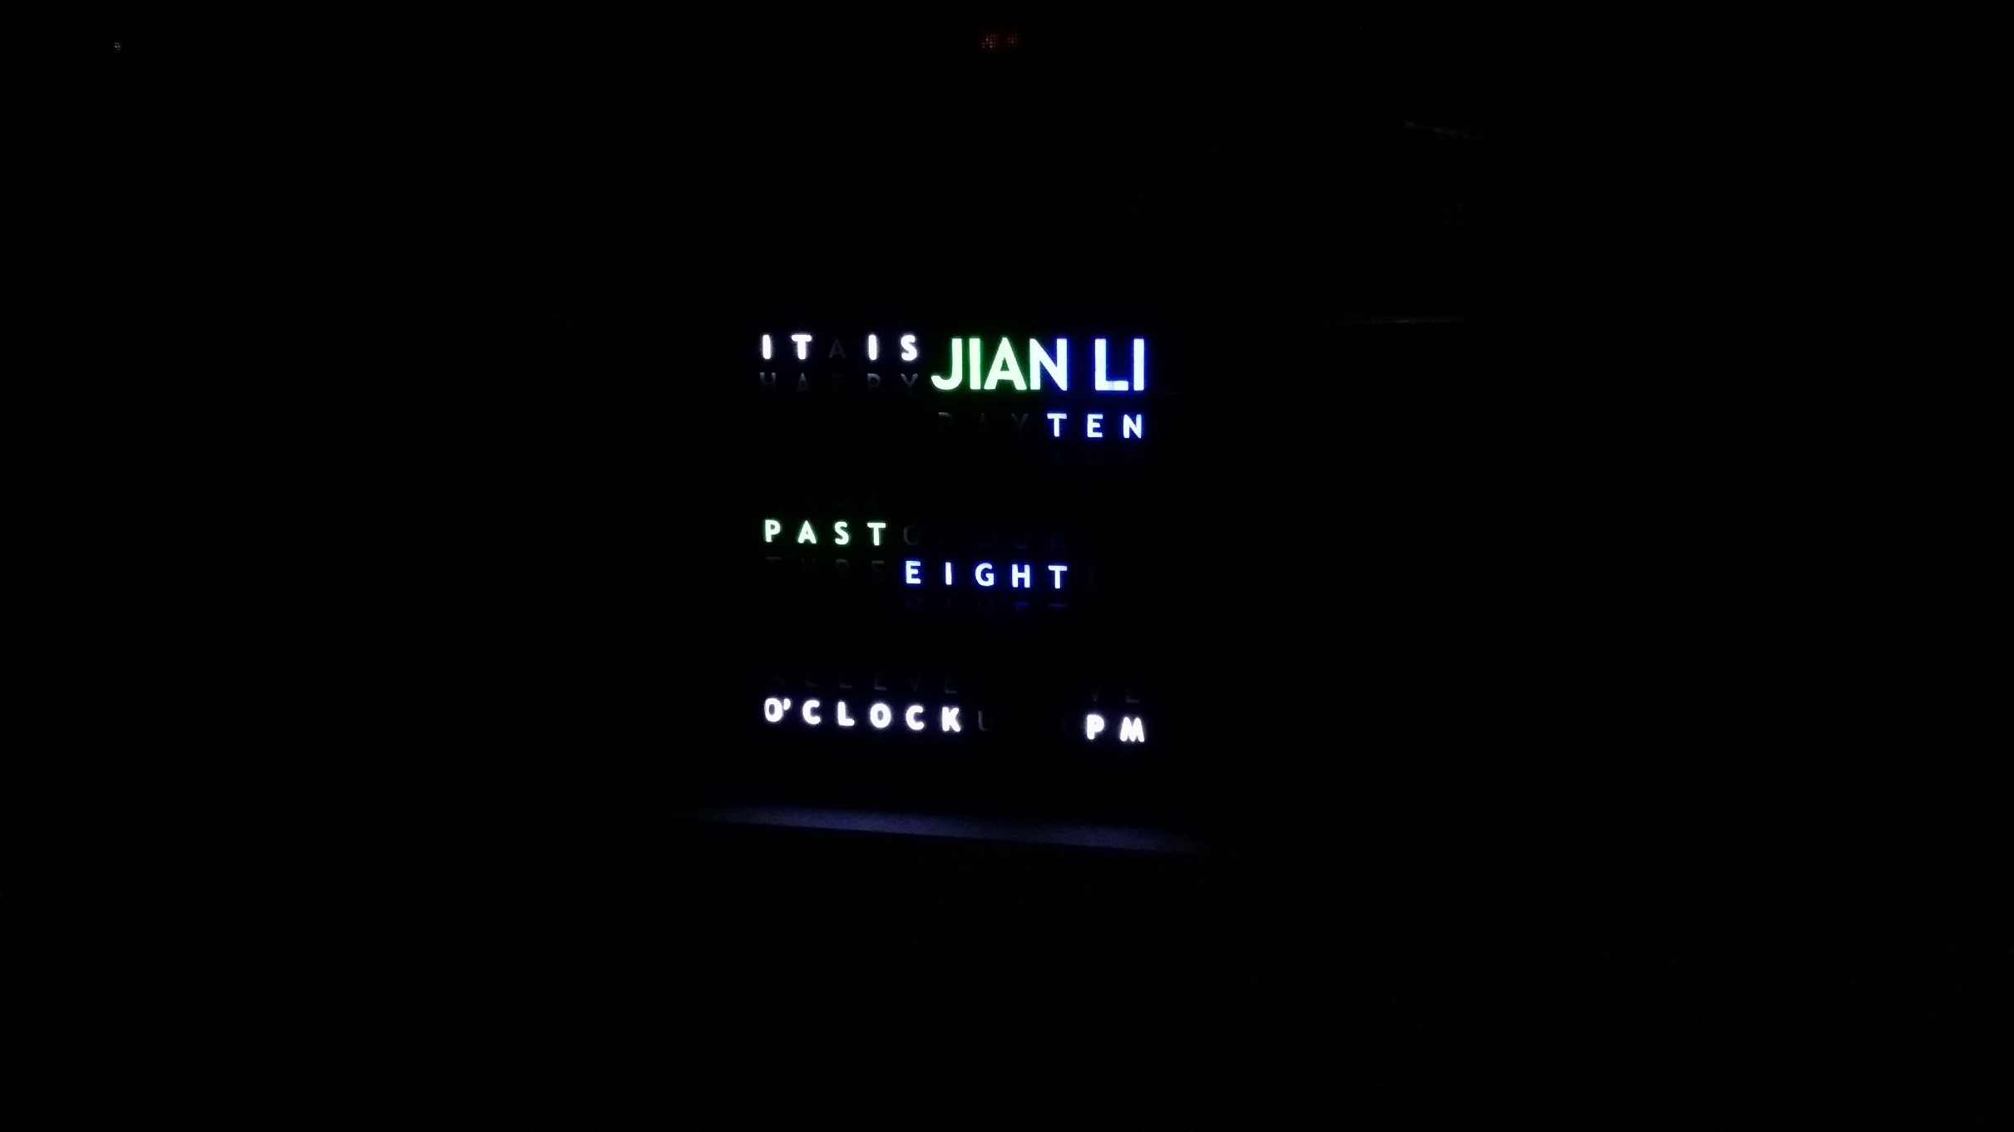
Notes:
In the night, the LEDs at full brightness may be too glaring for one to sleep. I added a function such that the clock dims the LEDs after 7pm. For this picture, I simply programmed the clock to display the time at the different brightness levels.

Slide 18
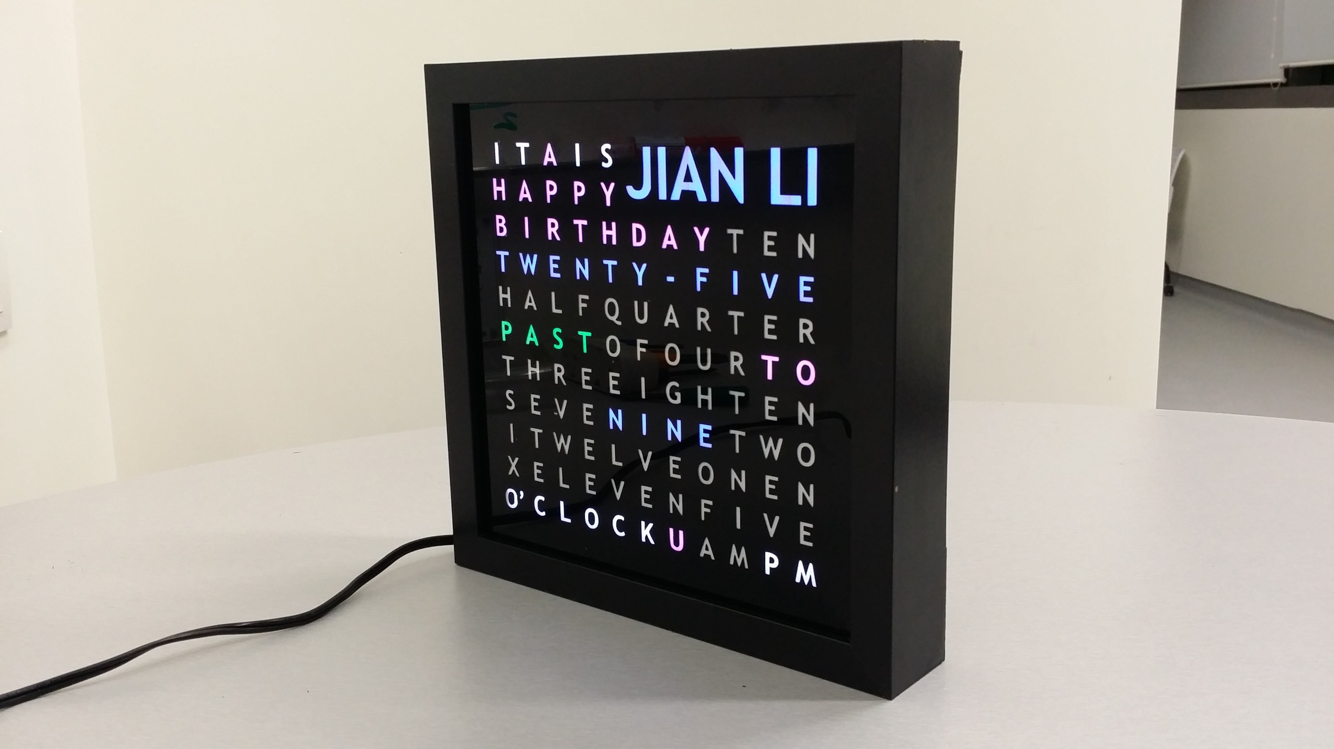
Notes:
Special messages can be displayed too. Since each letter is illuminated by an independently controlled LED, the messages can be reconfigured.

Slide 19
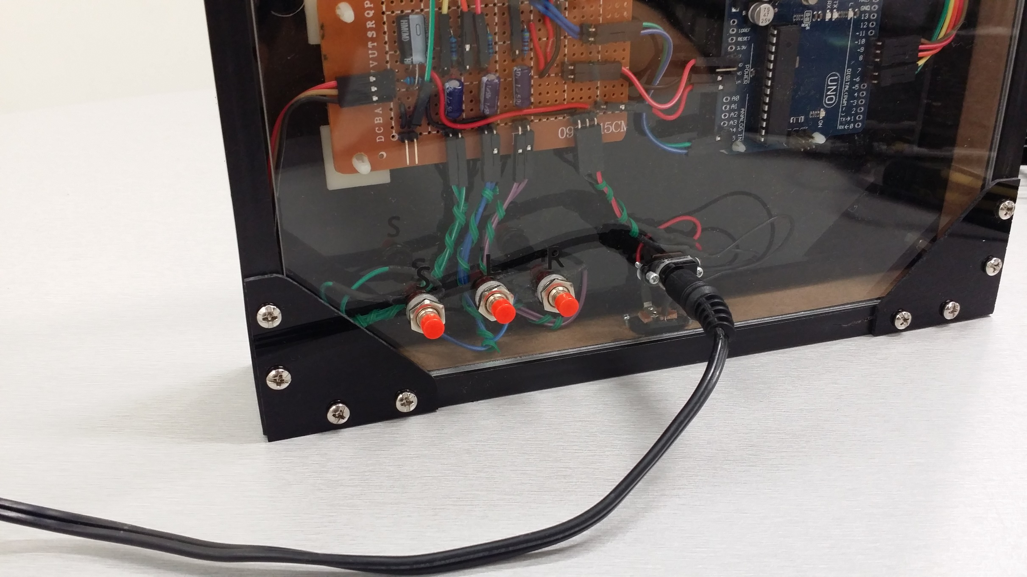
Notes:
The push buttons at the back allow for basic settings such as Brightness, Time, and Date etc. I can reprogram it to have additional setting modes.

Slide 20
Hoo Jian Li
hoojianli@gmail.com
Notes:
This brings me to the end of my presentation. If you would like to find out more about the Word Clock and how to make your own, you can contact me via email or when you see me around. Thank you.

